Slide 1
MAD SONGS
Search and discover

Slide 2
agenda
application’s concept
motivation for its development
design process
technologies used
Demo time
Directions for future development

Slide 3
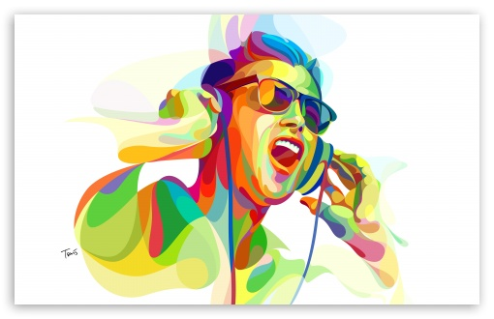
concept
Search for music
Get music
Get information on said music

Slide 4

Motivation for development
"I liberate minds with my music. That's more important than liberating a few people from apartheid or whatever" - Kanye West

Slide 5

Technologies used
Firebase
Musixmatch api
Youtube data api
boostrap
Computers

Slide 6

demo time!!!
Add some stuff here

Slide 7

Future development
we are going to replace the video <div> from the detail page into your brain
(coming Soon)*

Slide 8
Thank you!
Any questions?

